Slide 1

Apple Stock price Prediction
ARAVIND CHINNARI

Slide 2
Introduction
Data Cleaning: We start by filling missing values with column means and then proceed to check for data stationarity using ACF Plots, ADF, and KPSS Tests.
Data Transformation: To make the data suitable for modeling, we apply differencing to achieve stationarity.
Base Models: We establish a baseline with models like Average, Naive, Drift, SES, and Holt-Winter methods for initial test value predictions.
Feature Selection: OLS method is utilized to select essential features for our base models.
Advanced Models: For ARMA and ARIMA models, we determine model parameters (na, nb) using the GPAC table and conduct diagnostic tests.
Model Selection: We choose the best model based on metrics like mean, residual variance, and forecast error.
Visualization: To provide clarity, we present forecasted values with clear differentiation.

Slide 3
Dataset Description
Dataset Overview: The dataset consists of 10,468 rows and 7 columns, providing a substantial amount of data. This data is collected between 1980-2022.
Date Range: The dataset covers a wide date range with unique values for each date, spanning from the earliest recorded data to the most recent.
Key Metrics: Essential financial metrics such as Open, High, Low, Close, Adjusted Close, and Volume are included.
Data Statistics: The statistical summary shows key metrics' characteristics, including mean, standard deviation, minimum, maximum, and quartile values.
Data Completeness: The count of non-missing values in each column indicates data completeness.
Price Range: The dataset contains price data with a minimum of approximately $0.05 and a maximum of approximately $182.63.
Target Variable : Open Price
Kaggale link :

Slide 4
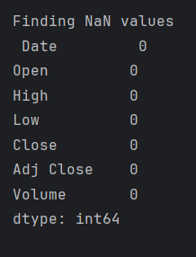
Data cleaning
Firstly, checked if there are any missing values in the dataset.
There are zero missing values in every column and we can say we have each and every data from 1980 to 2022.
Transformed the date column to a datetime format by using pd.to_datetime(data[‘Date’])

Slide 5
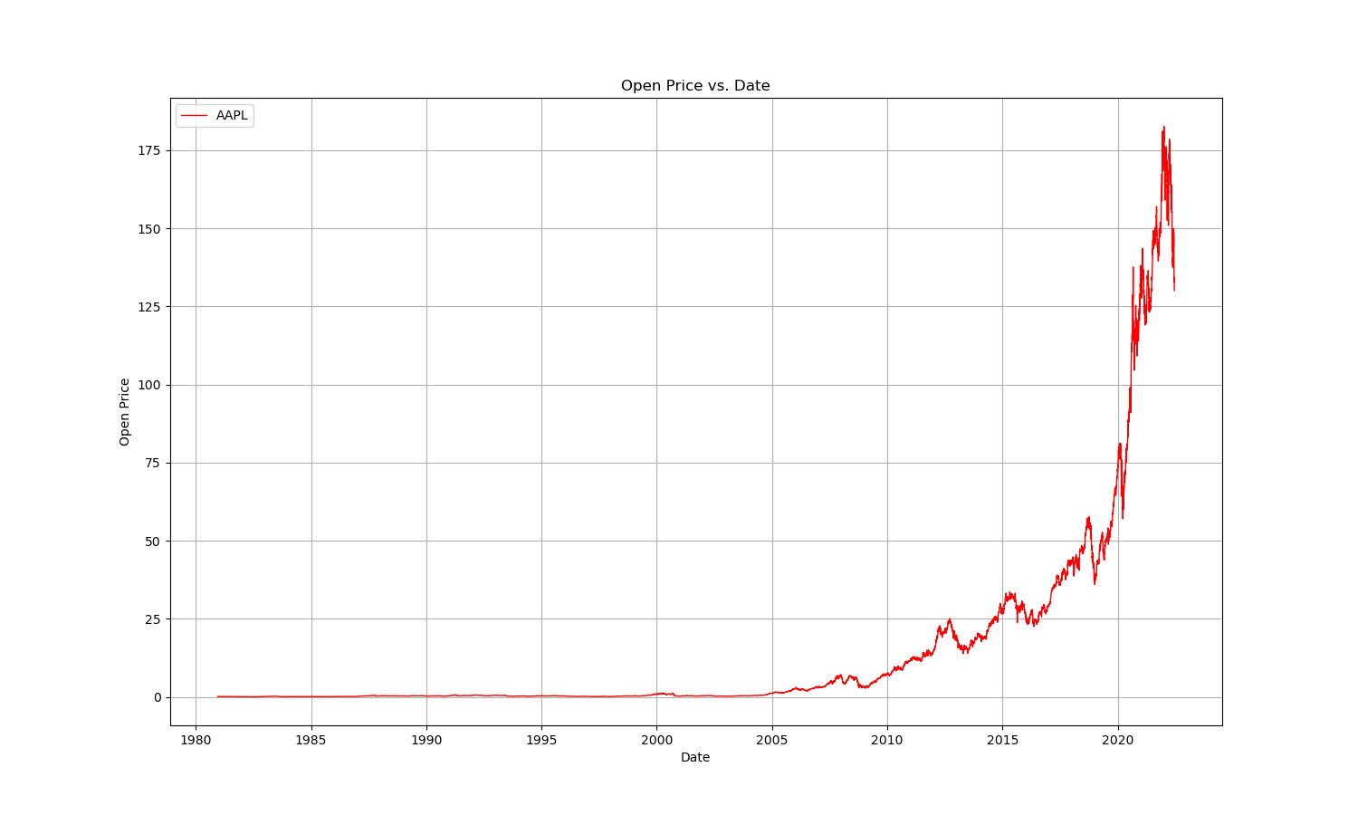
Plot for open price Vs date
This is the line plot plotted between open price vs Date .
This plot shows the change in a variable over time. The horizontal axis (x-axis) shows the time periods, and the vertical axis (y-axis) shows the values of the variable. In this case, the y-axis might be showing the temperature, and the x-axis might be showing the time of day. The line plot shows that the open price is increasing over time.

Slide 6
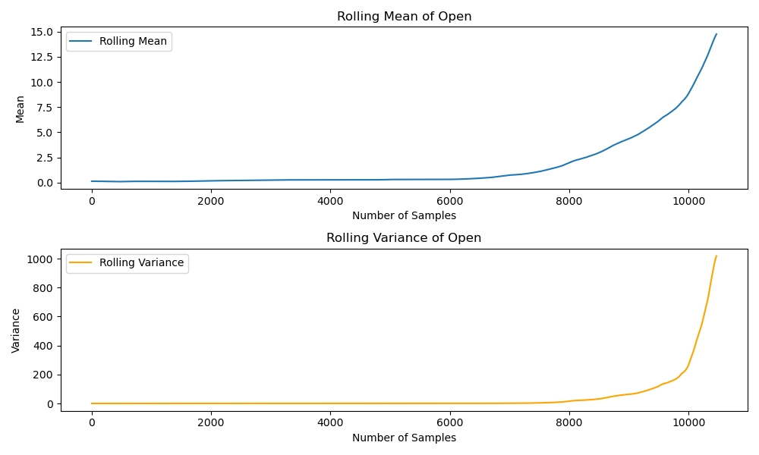
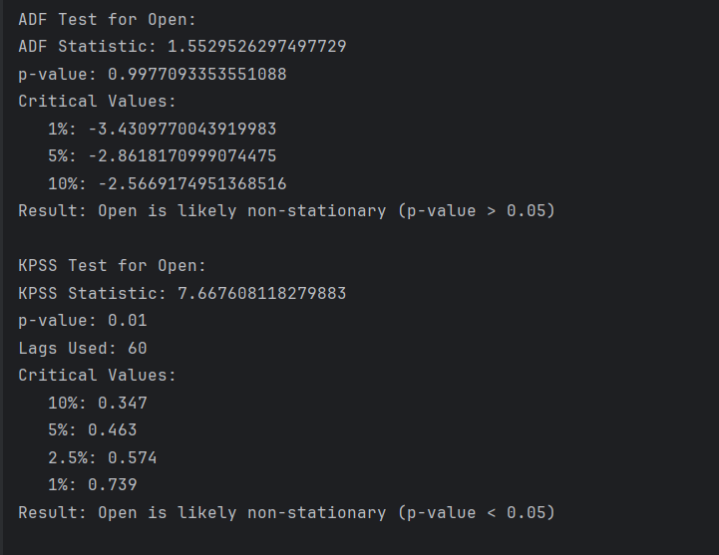
Stationarity Check:
Here we plotted rolling mean and rolling variance to check wether the data is stationary or not.
Also we perform ADF and KPSS test to know the stationarity of the data, as per test statistics we getting the data is non-stationary.

Slide 7
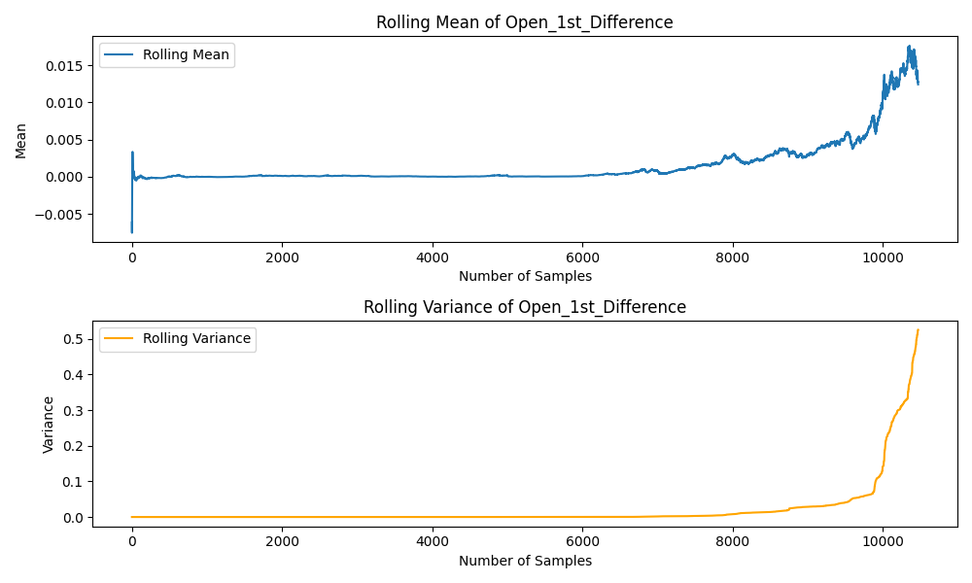
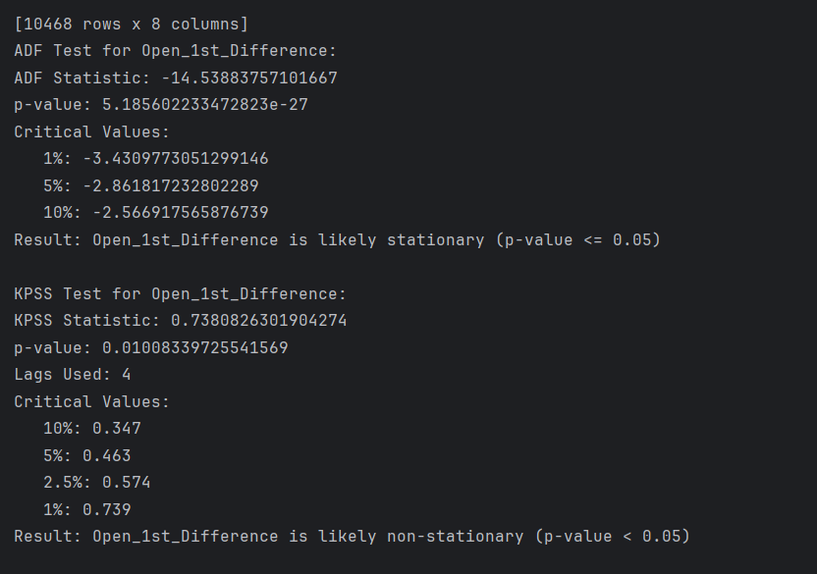
Stationarity Check After 1st order differencing:
Here we plotted rolling mean and rolling variance as per plot we can see the mean is constant and constant variance now.
Also we perform ADF and KPSS test after 1st order differencing and test statistics still not satisfies the data is stationary.

Slide 8
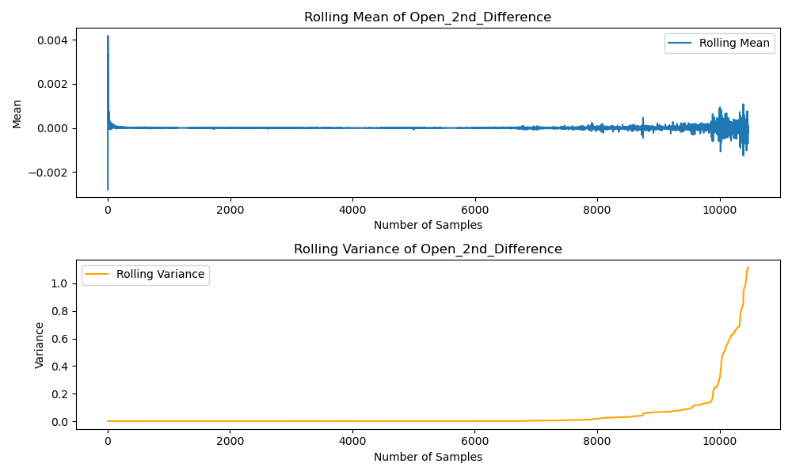
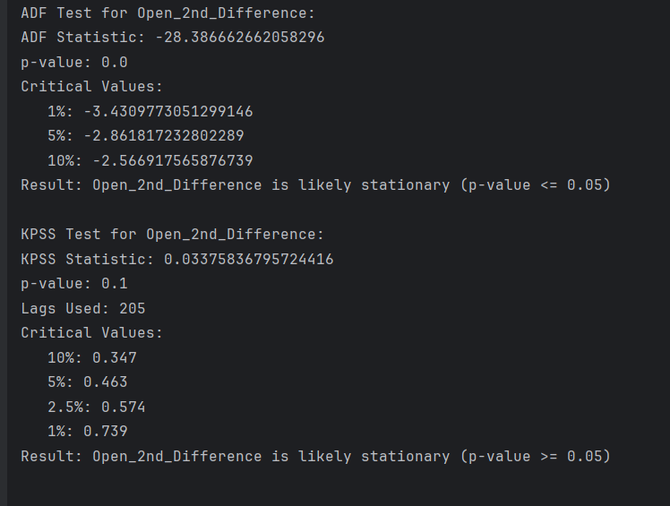
Stationarity Check After 2nd order differencing:
Here we plotted rolling mean and rolling variance as per plot we can see the mean is constant and constant variance now.
Also we perform ADF and KPSS test after 2nd order differencing and test statistics satisfies the data is stationary.

Slide 9
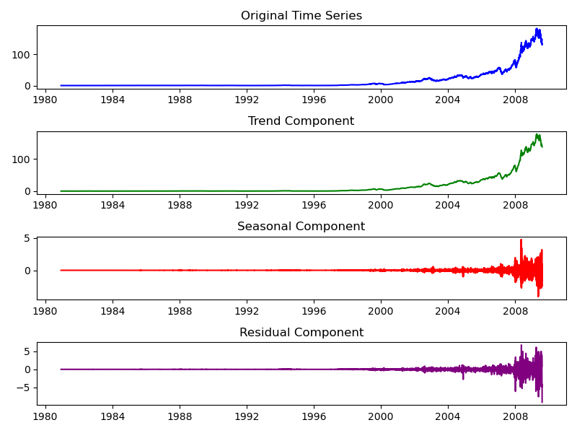

Time Series Decomposition
Based on the provided values, the data set appears to have a strong trend component (99.976%) and a moderate seasonality component (30.018%). Therefore, the data set is more strongly trended than it is seasonally affected

Slide 10
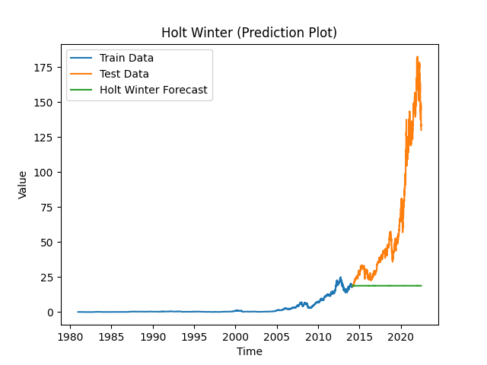
Holt-Winters Method
We can observe that the Holt winter method did not give good predictions as it is not following the test results.

Slide 11
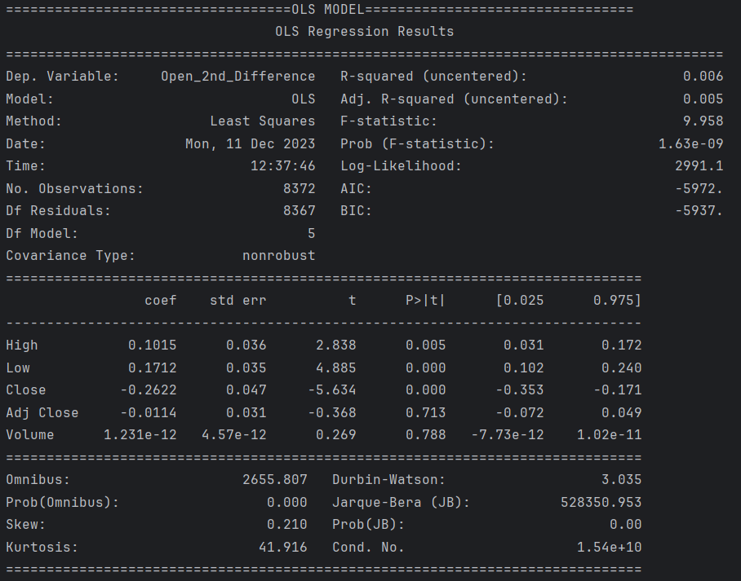
Feature selection:
Initial summary of Ols regression model.

Slide 12
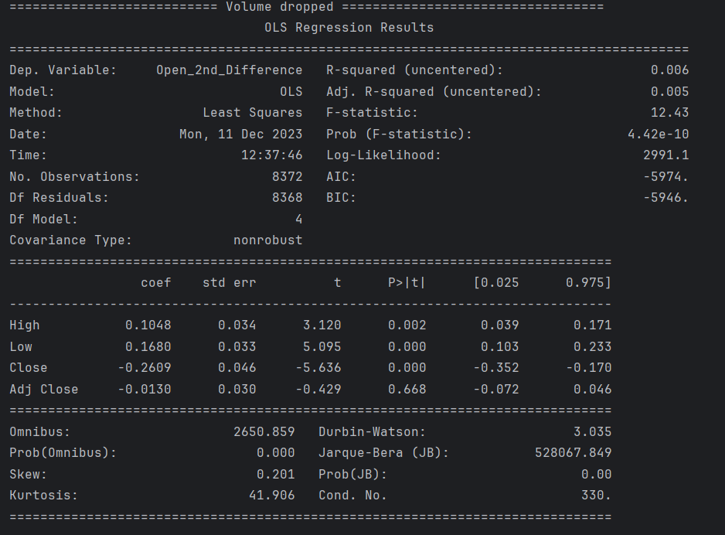
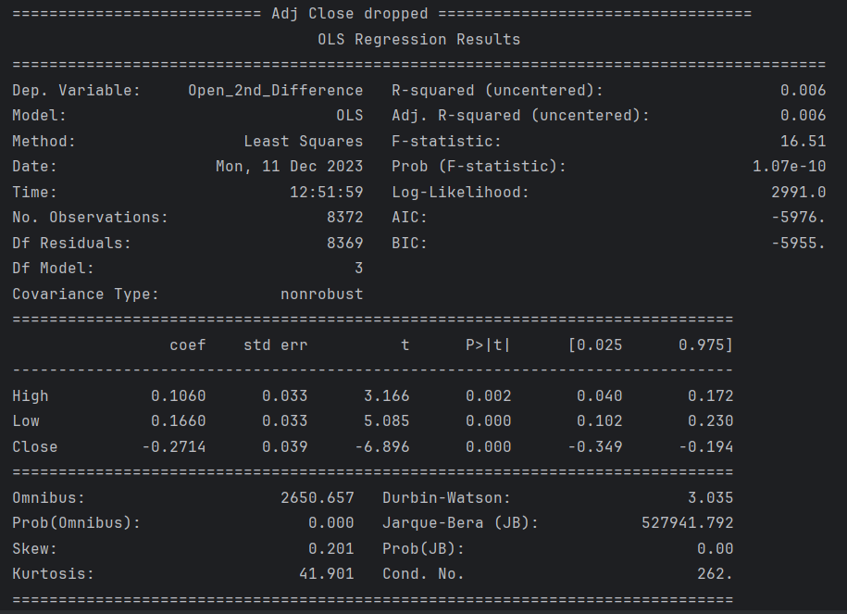
Removing of volume and adj close due to high p-value:

Slide 13
Final result of feature selection:
This is the final result after removing volume and adj close features.

Slide 14
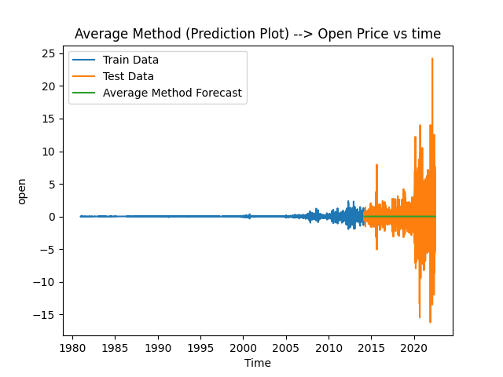

Base models:
The above plots are for Average and Naïve method models.
The graph demonstrates that the average method's forecast, covering the length of the test dataset, mirrors the average value derived from the train dataset.
The graph illustrates that the naive method's forecast for the duration of the test dataset corresponds to the final value observed in the train dataset.

Slide 15


Base models:
The graph demonstrates that the drift method's forecast over the test dataset length extrapolates from the line connecting the initial and final values observed in the train dataset.
The graph we can see that the forecast of the SES method for the length of the test dataset follows the SES equation. The results are similar to the Holt winter model forecast.

Slide 16
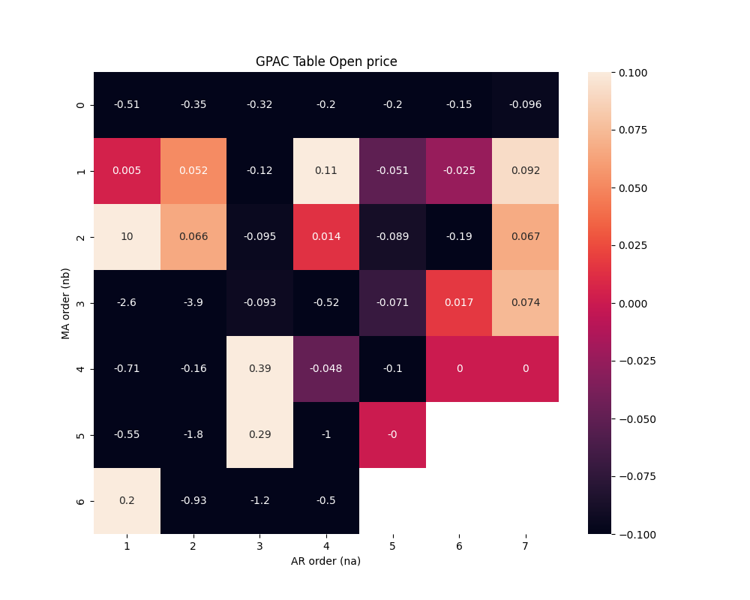
Gpac table:
This is the GPAC table used to find the order to build a model.
But I didn’t seen any pattern using gpac table.
To find the order , in coming steps I used AutoArima to find the best order for our dataset to build model.

Slide 17
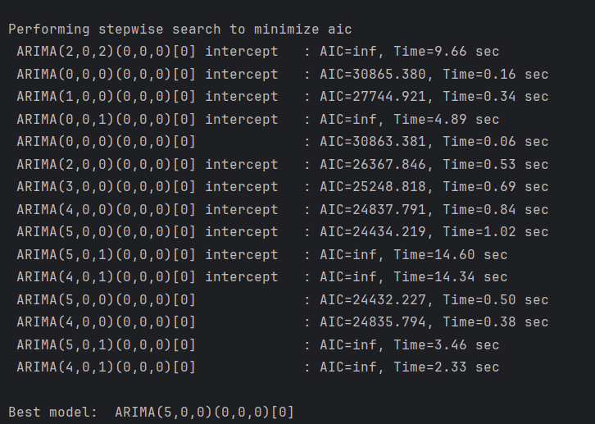
Auto arima:
This is the AutoArima function I used to find order of my dataset.
After making many trails the autoarima suggests me that the best order is ARIMA(5,0,0)
Which means na = 5 and nb = 0

Slide 18
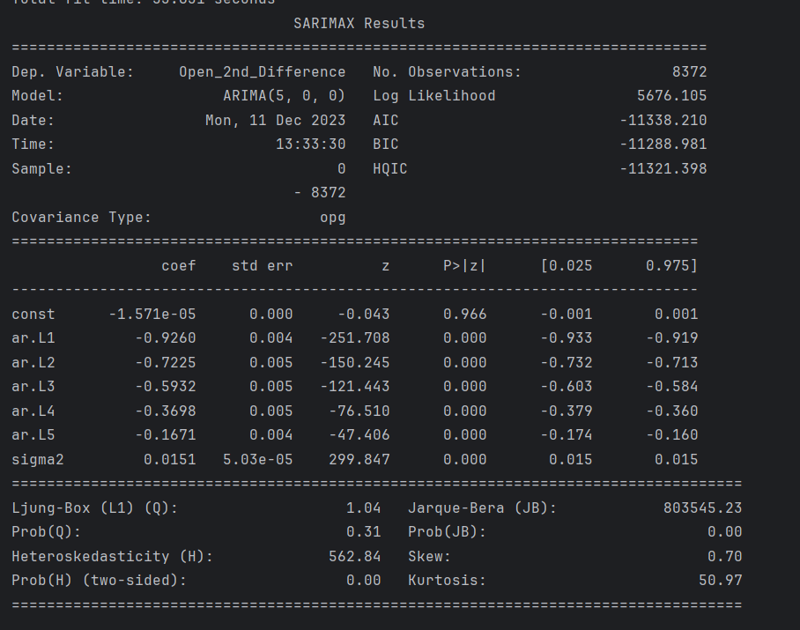
Arma model:arma(5,0)
Key metrics showcase a high Log Likelihood of 5676.105, favorably low AIC (-11338.210), and BIC (-11288.981), indicating a superior model fit. The Ljung-Box test (Q-statistic) indicates non-significant autocorrelation in residuals, suggesting a lack of residual patterns. However, the Jarque-Bera test (JB) reflects potential deviation from normality, given its non-zero p-value
The ARIMA(5, 0, 0) model depicts a robust fit to the dataset capturing intricate temporal dependencies within the Apple stock prices.e.

Slide 19
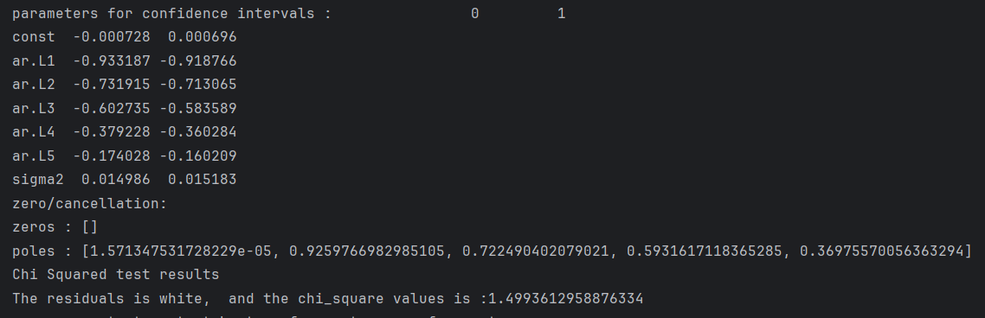

Diagnosis testing:

Slide 20
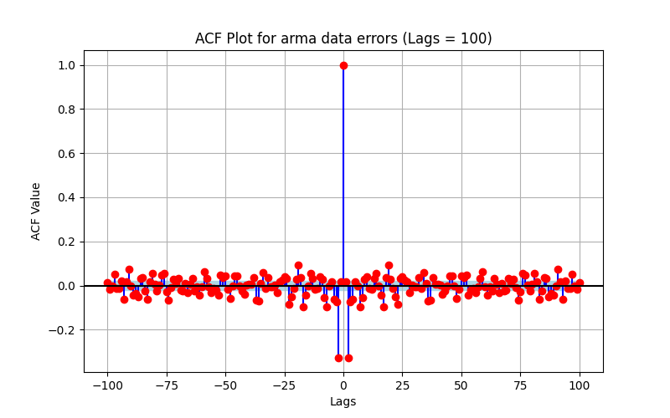
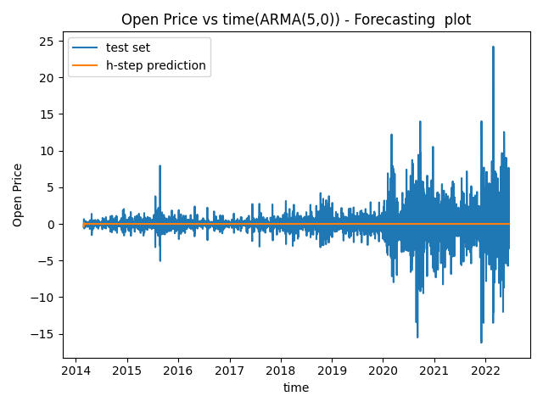
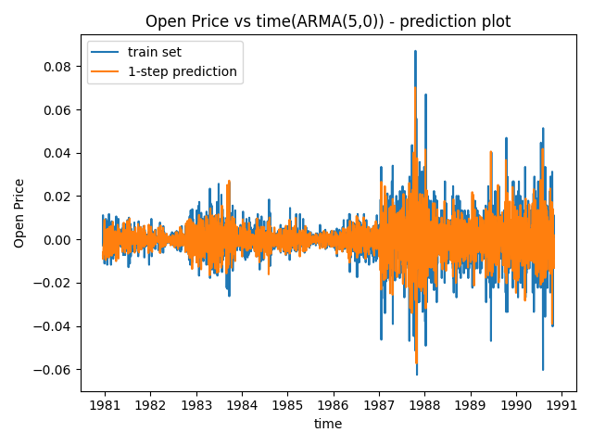
Arma(5,0) plot:
From ACF Plot, we can observe that residuals are white, and we can confirm this with additional chi-square results.

Slide 21
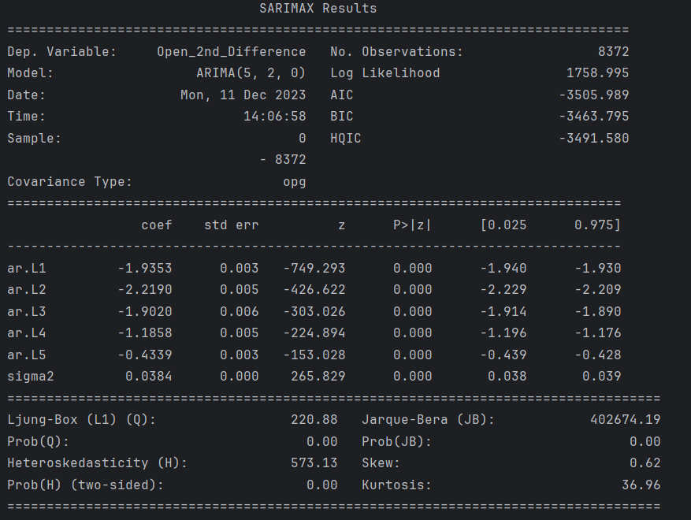
Arima model: arima(5,2,0)
The ARIMA(5, 2, 0) model portrays a strong fit to the Apple stock price dataset, effectively capturing complex temporal relationships.
Key model metrics indicate a Log Likelihood of 1758.995, reflecting a reasonable fit. The AIC (-3505.989) and BIC (-3463.795) scores reinforce the model's appropriateness. However, the Ljung-Box test highlights potential autocorrelation in residuals at lag 1, warranting further investigation or possible model refinement.

Slide 22
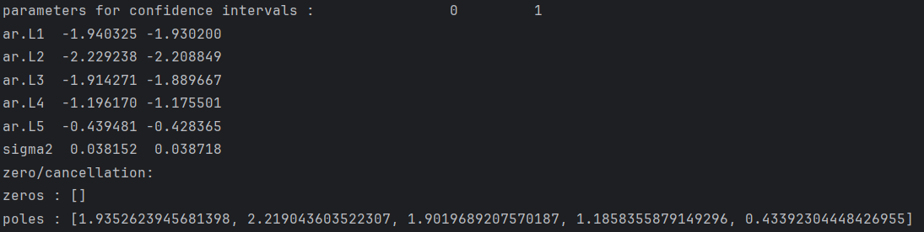


Diagnosis testing:

Slide 23

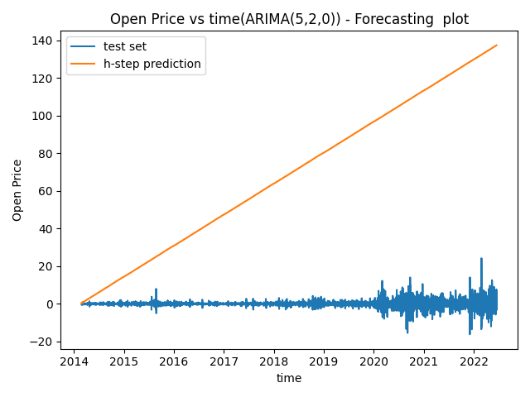
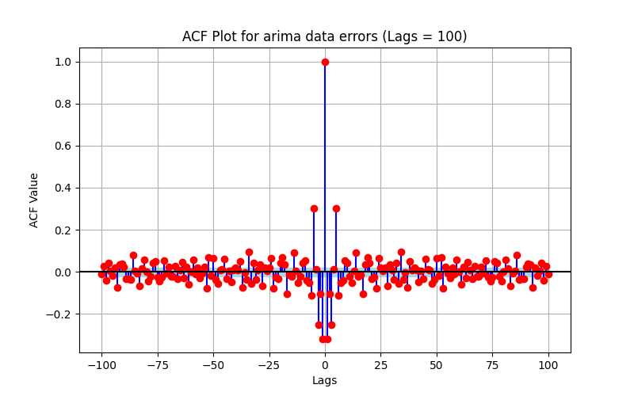
Arima(5,2,0) plot:
From ACF Plot, we can observe that residuals are white, and we can confirm this with additional chi-square results.

Slide 24
Summary and conclusion:
Data Pre-processing: The initial dataset underwent preprocessing to handle missing values, followed by segmentation for Chennai-specific data analysis.
Stationarity Testing:
Stationarity checks were performed, necessitating a 1st order differentiation step to achieve stationarity within the data.
Base Models Evaluation:
Base models (Average, Naive, Drift, SES, Holt-Winters) were initially employed, but their performance fell short of expectations due to the dataset's complexity.
ARMA and ARIMA Model Selection:
GPAC table and auto ARIMA techniques were employed to determine the appropriate parameters for the ARMA and ARIMA models.
Model Construction and Comparison:
ARMA(5,0) and ARIMA(5,2,0) models were constructed and tested. Upon comparison, ARMA(5,0) exhibited superior performance.
Model Comparison Metrics:
ARMA(5,0) was deemed the better model due to its lower variance in both residual and forecast errors, showcasing its stronger predictive ability.
Conclusion:
The ARMA(5,0) model emerges as the preferred choice, demonstrating its capability to provide more accurate predictions for the dataset, with lower error variance and enhanced forecast reliability.

Slide 25
References:
Lecture Notes and Videos
Labs, Assignments and Exam codes
https://www.kaggle.com/datasets/meetnagadia/applestock-price-from-19802021

